Slide 1
Drug designer database
Carlos Dominguez(Developer, Tester, scrum master, everything…) Product Owner: Dr. Luis Arroyo

Slide 2
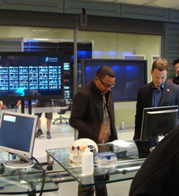


Presentation
What’s my project about?

Slide 3
Stories in spring 4
User Story | Estimated | Current
#264 export defect | 8 | 8
#247 import defect | 16 | 13
#248 add compound defect | 4 | 4
#249 compound information defect | 4 | 4
#250 edit compound defect | 8 | 7
 | 40 | 38 | Total
38 ---- = 0.95 points per hour 40
Total Speed =

Slide 4
Mingle Daily Scrum
Daily Scrum # | Date | Action
268 | 6/4/2015 | Import Defect | 4 hrs
269 | 7/4/2015 | Import Defect | 3 hrs
270 | 8/42015 | export Defect | 4 hrs
271 | 9/4/2015 | export Defect | 4 hrs
272 | 10/4/2015 | Add compound defect | 4hrs
273 | 13/4/2015 | Add compound defect | 4 hrs
274 | 14/4/2015 | Compound information defect | 4 hrs
275 | 15/4/2015 | Compound information defect | 3 hrs
276 | 16/4/2015 | Edit compound defect | 4 hrs
277 | 17/4/2015 | Meet with client | 1hr

Slide 5
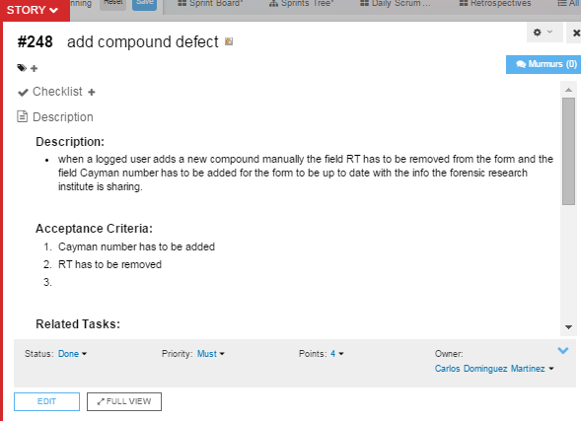
Add compound defect

Slide 6
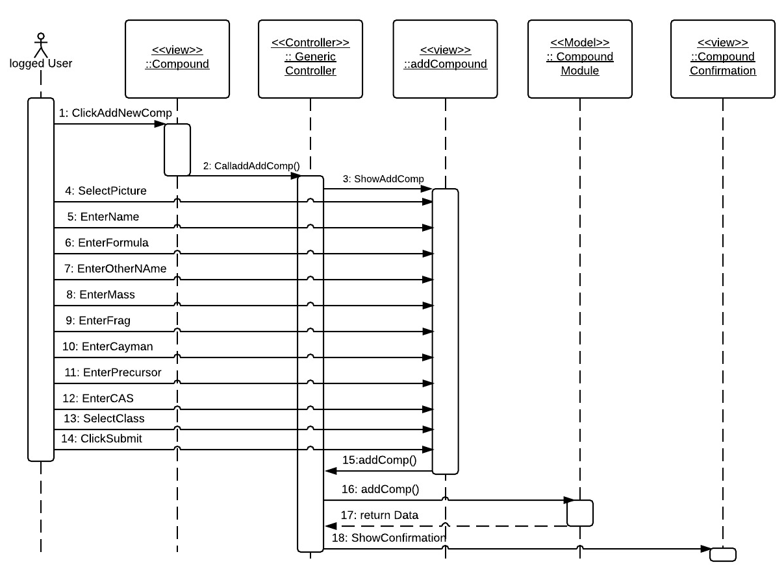
Add Compound Sequence diagram

Slide 7
Add Compound Test Case
Name: add new Compound
Participating actor: either an admin or a labOP
Entry condition: User is logged in the system User is in compound page.
Exit condition: Compound data is added in the system and pop up is shown
Event flow: User click on the add compound button System shows add compound form page User selects the picture of the compound, enters “Test ” in name field, enters “Test” in formula field, enters “Test” in other name field, enters “5” in mass field, enters “5” in fragments field, enters “Test” in Cayman Number, enters “5” in precursor field, enters “6” in CAS field, select “Test51” as compound class and click submit all button. System confirm that compound has been saved with a pop up

Slide 8
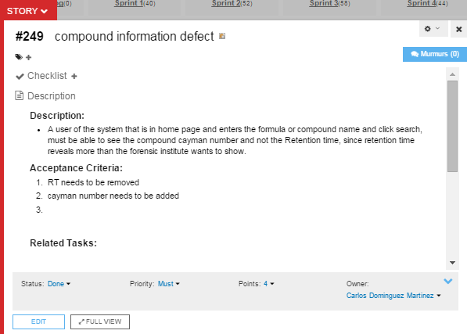
Compound information Defect

Slide 9
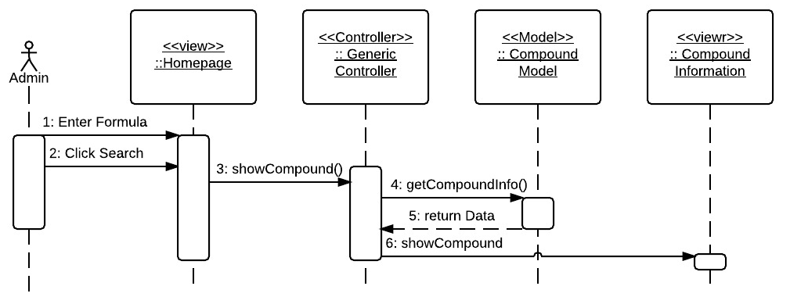
Compound Information sequence Diagram

Slide 10
Compound Information Defect Test Case
Name: Search For Compound
Participating actor: any user of the system
Entry condition: User is in main page or home page
Exit condition: User found the data of the search compound
Event flow: User enters “Test” in the search criteria box and click the search button. Systems show the information of the compound

Slide 11
DEMO

Slide 12
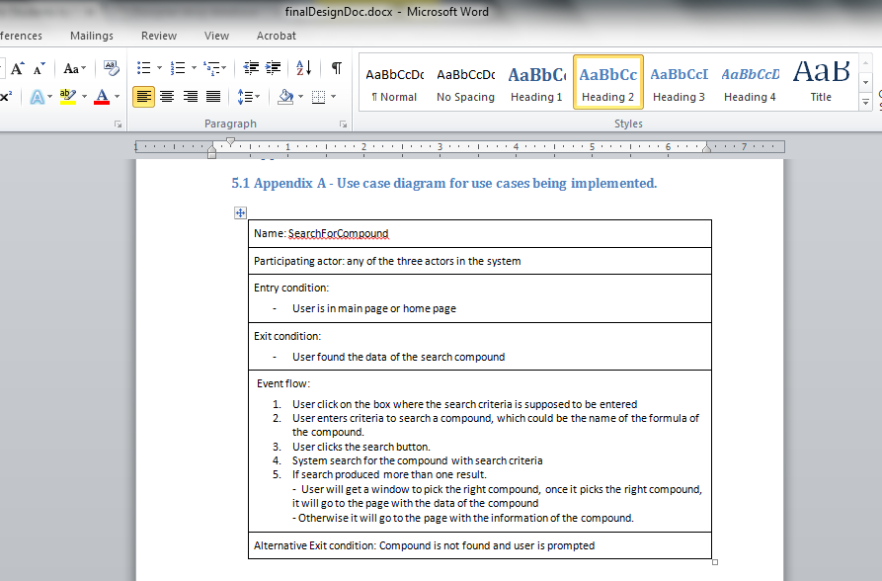
Designed documents

Slide 13
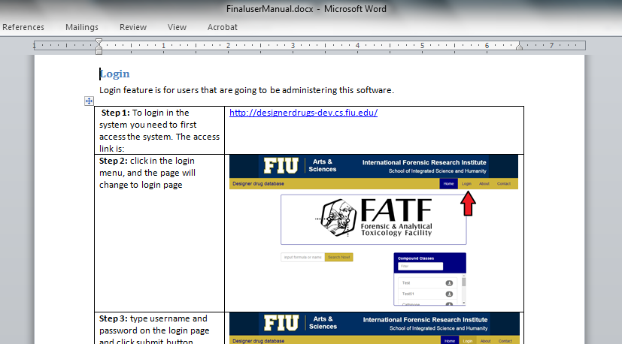
User Manual

Slide 14
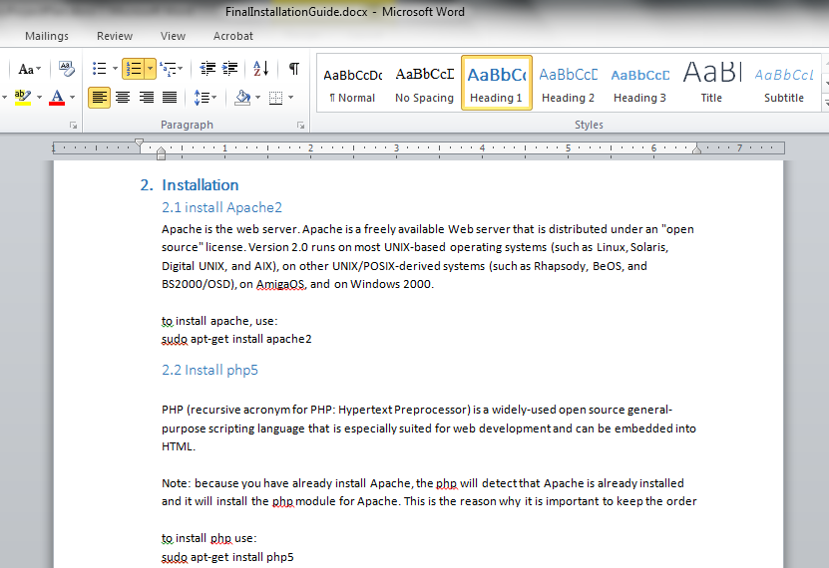
Installation guide

Slide 15
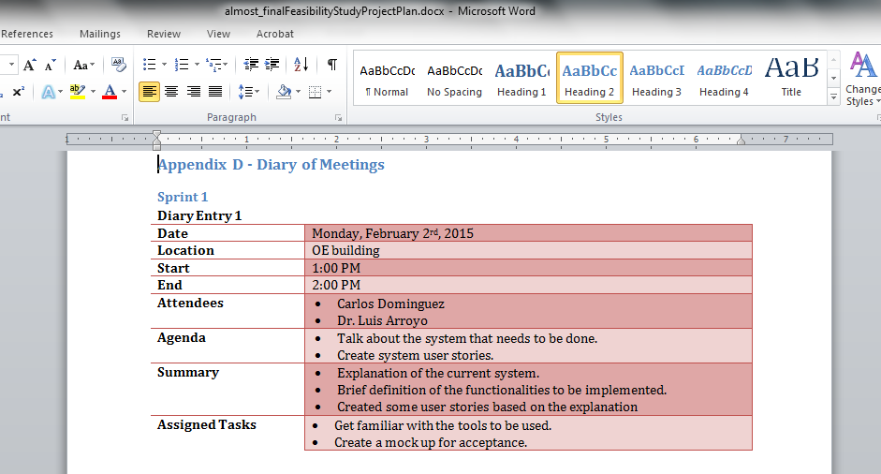
Fesibility Study & Project Plan

Slide 16
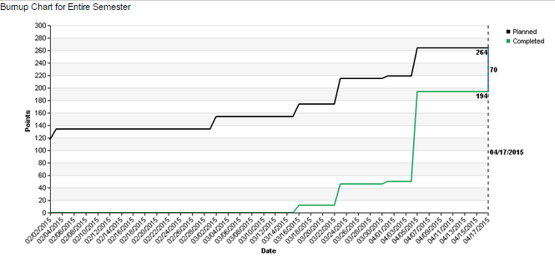
BurnUP Chart

Slide 17
The end

